Slide 1



Slide 2
" In The Name of Allah, The Most Beneficent, The Most Merciful"
Skills in Controlling Critical Points in the Halal Industry and its Services.
A prerequisite for Halal Lead Auditor
Halal Analysis & Critical Control Points in the Halal industry and its Services
(Introductin & Applications)
By: Dr. Hani M. Al-Mazeedi

Slide 3
Scope
This presentation shed the light on the importance of identifying Hazards of religious nature within the Halal chain, to put control over them, and to be identified as Halal critical points to formulate HACCP-Halal, as a proactive system to ensure perfection of Halal certification process.

Slide 4
Outline
Introduction
Why HACCP?
Definition of HACCP
Definition of Prerequisite Programs, PRPs
Applying HACCP in the Halal industry?
Conclusion
Recommendations

Slide 5

Introduction
The HACCP-Halal, is basically the same as the international food safety system, i.e. Hazard Analysis & Critical Control Points, HACCP, where the standard Hazards are: Microbial, Chemical, and Physical, however, the Hazards in HACCP-Halal has an additional hazard of a religious nature that aim to maximize the effectiveness of the Halal system.
-Halal

Slide 6
The HACCP-Halal system within the complete Halal production chain include the following 7 essential steps:
The establishment of procedures that will identify¹, monitor⁴ potential Hazards, and critical control points² of religious nature.
The establishment of corrective actions⁵ in case of deviation from established Halal critical limits³.
The establishment of an effective record-keeping⁶ and verification system⁷.

Slide 7
Potential hazards of religious nature in HACCP-Halal are:
Non-Halal processing steps.
Presence of ingredients that are Haram, Suspected, or Makrooh in the production / preparation of Halal products or services.
Presence of ingredients that are non-Tayyib in the production / preparation of Halal products or services.

Slide 8
Halal critical control points include one or more of the following stages:
Halalness & quality of incoming raw materials.
Storage of raw materials.
Cleaning agents.
Equipment and utensils.
Pre-production and production processes.
Packaging, labeling of, and storage Halal products .

Slide 9
We will focus in HACCP-Halal on how to control Halal critical points to ensure Halal & Quality (Tayyib) in Halal products from production to use.

Slide 10
Why HACCP?
HACCP or ISO 22000 is an approved international food safety system to ensure safety in food.

Slide 11
Advantages of HACCP
  A system that identify what should be done to make food safe.
  It ensures us that what has been planned for is being applied properly.
  A system that focuses on elements that linked to food safety and encourage their improvements.

Slide 12
It is a proactive system that deals with actions before they happens as an alternative to testing final products (i.e. it minimize the size of rejected food items).
It is a system that require a number of controls to prevent or minimize the incidents of Hazard occurrences.

Slide 13
It is a system that provide a practical mean of educating employees in food establishments.

Slide 14
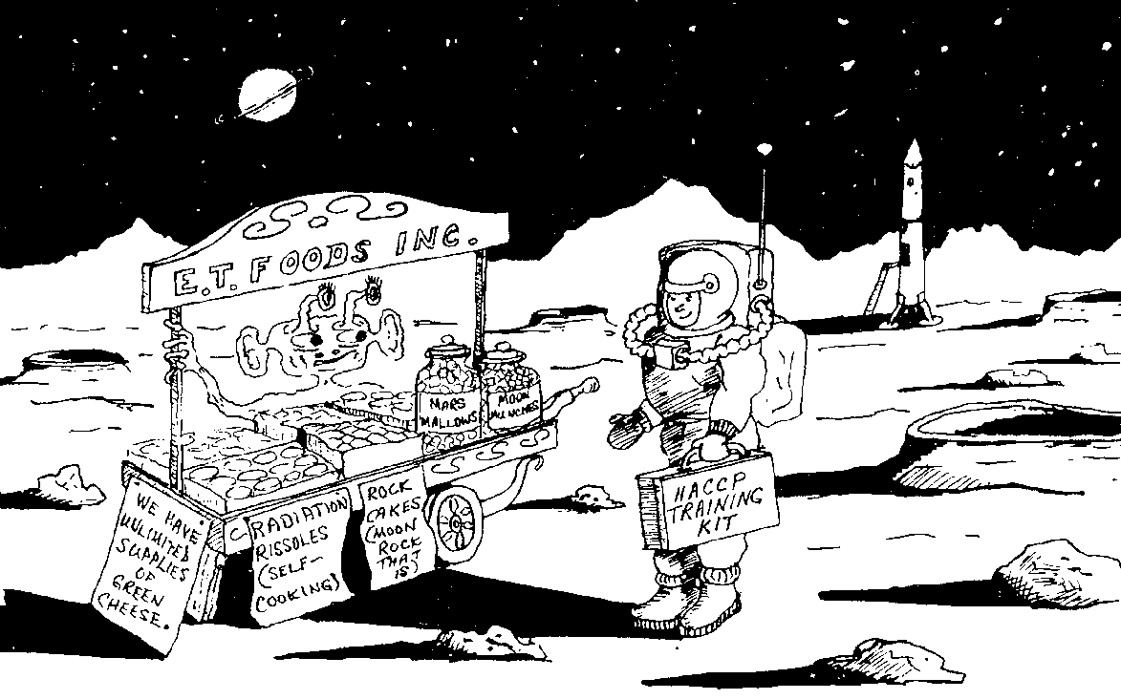
Notes on the early uses of HACCP
Control of food safety in the space era by
NASA

Slide 15
In 1968, during the period of Apollo travel to the space, NASA has requested from the Pillsbury food company to develop a food safety system that protect the safety of space astronauts from Hazards that may be contained in the food they eat.

Slide 16
The concept of food safety system of the Pillsbury food company was developed in 1959 by Howard Bauman.

Slide 17
The food safety system of Howard Bauman consist of 3 of the 7 HACCP Current principals:
These 3 principals were based on
Identify and Control

Slide 18
The Food safety concept initially developed by the Pillsbury food company was improved in association with NATICK laboratories of the US Army where their food safety system was utilized in the
Analyzing modes of failure

Slide 19
And it was in 1992 the 7
principals of HACCP
was developed
1992

Slide 20
Requirements of NASA project was
To apply control over:
Raw Materials
Processing
Working environment
Employees

Slide 21
The Purpose of applying HACCP
Protection against food born disease
Increasing the efficiency
of Quality
Assurance
system
Lowering
The cost of
food analyses
Lowering
food losses
as a result of
recalls
Protecting the reputation

Slide 22
Definition of HACCP
It is a complete system that uses 7 principals to analyze any food operation with the identification of potential Hazards of its three categories (Microbial, Chemical, or Physical) in its different manufacturing steps with the application of inspection and control measures of low costs for the purpose of having safe and hygienic food.

Slide 23
Since its establishment, an additional fourth Hazard has drawn the attention of Muslim scientists, that is of religious nature:
The Hazard of the use of non-Halal processing systems, or the presence of Haram, Najis, Mashbooh, Makrooh or non-Tayyib materials in the final product.

Slide 24
HACCP put an emphasis on:
The importance of evaluating Prerequisite Programs before applying it in any food establishment.

Slide 25
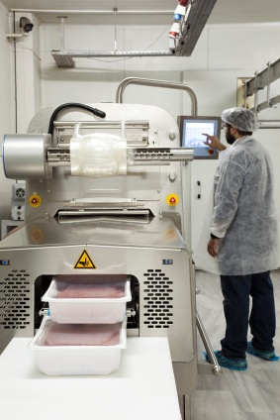
Prerequisite Programs
PRPs
For Food Safety Management Systems
It is the Quality (Tayyib) aspects of Halal

Slide 26
Definition of Prerequisite Programs, PRPs
Programs and practices put in place to ensure that the environment is safe, clean, sanitary and appropriate for manufacturing safe product.
PRPs include the programs that many food processors call GMPs.

Slide 27
Examples of Prerequisite Programs (GMPs)
Cleaning and sanitizing
Management of cross contamination
Waste disposal
Pest control
Equipment suitability (cleaning and maintenance)
Food defense
Warehousing
Recall and withdrawal
Personnel hygiene
Management of purchased materials

Slide 28
The philosophy of HACCP
Not to skip any operation affect the safety of food to mention but few:
    Raw materials
    Product combination
    Production circumstances
    Storage
    Distribution
    Preparation
    Marketing<
    Individuals

Slide 29
Requirements and principals of HACCP
7
Principals
5
Requirements
And
Conduct Hazard Analysis
6
1
Assemble a HACCP team
Determine Critical Control Points, CCPs
7
Describe Product
2
Establish Critical Limits for each CCP
8
Identify Intended Use
3
Establish a monitoring system for each CCP
9
Construct Flow diagram
4
Establish Corrective Actions
10
On-site Confirmation of Flow Diagram
5
Establish Documentation and Record Keeping
11
Establish Verification Procedures
12

Slide 30

How we can apply HACCP in
the Halal industry?
HACCP-Halal
-Halal
Application of
HACCP in the Halal Industry

Slide 31
1- Conduct Hazard analysis
Identify potential hazard of religious nature to each of the products in its complete chains so that appropriate procedures can be designed to monitor it and get read of it.

Slide 32
Potential religious hazards are divided into two categories:
potential religious hazards that cannot be tolerated
potential religious hazards that can be tolerated

Slide 33
potential religious hazards that cannot be tolerated
It is stages or points in slaughtering or processing that cannot be accepted because it clearly contradicts with the requirements of Islamic Sharieah based on text from Holly Quran or Sunnah or by consensus of Muslim Scholars.

Slide 34
Examples of potential religious hazards that cannot be tolerated
Presence of meat, fat, or gelatin or any parts of pig.
Presence of gushed blood in a manufactured product.
Absence of acceptable religious cleansing (Tahara) of production lines.
The use of stunning that lead to death or that disturb the prescribed conditions of Halal Zabiah.
The use of mechanical slaughtering knife or not slaughter in the right place.
The presence of by products of insects or non-Halal slaughtered animal.

Slide 35
2. potential religious hazards that can be tolerated
It is stages or points in slaughtering or processing that can be accepted and avoiding it is based on hatred or on preference.

Slide 36
Examples of potential religious hazards that can be tolerated
Forgetting (non deliberate) uttering the name of Allah at the time of slaughter (in some schools).
Forgetting directing the bird or animal at the time of slaughter toward Qibla (Makkah).

Slide 37
2- Determine critical control points, CCPs
Critical Control Points (CCPs) are steps in processing that when we lose control or monitoring over them may lead to unacceptable Hazard (or unacceptable decontamination). To determine CCPs we need to use the decision tree making.

Slide 38
For example:
Identify whether there is a critical control points, CCP in:
Raw materials (presence of non-Halal ingredient of animal origin).
Possible contamination with non-Halal materials during processing.
Presence of non-Halal carcasses or meat near Halal carcasses .
Use of very low quality meat or low quality raw materials.
Use of non-Halal slaughtering methods.

Slide 39
How can we determine Critical Control Point
By using
HACCP decision tree making to identify CCP
We can determine whether a step is
a critical control point (CCP) for identified Hazard or it just need PRPs.
PRPs
CCP

Slide 40
CCP
Example: Cocking meat, or Pasteurizing milk.
Could this Hazard be controlled by PRPs? NO
Is there a control procedure in any processing step? Yes (Pasteurization)
Is the exposure to this Hazard may exceed the limits and beyond? Yes
Is the controlled procedure designed to remove or minimize the Hazard to an acceptable limit? Yes (the microbial Hazards)
Can another procedure on the processing line remove or minimize the Hazard to an acceptable limit? NO
CCP-M1
M: Microbial

Slide 41
And in small establishments, we may overcome the use of the HACCP decision tree to identify CCP by asking this question:
If we lost control, will it possibly cause Hazard to the product?
If the answer is yes, it is a critical control point, CCP.

Slide 42
Always remember
To identify a CCP: Its Hazard should not be removed by subsequent production steps.

Slide 43
3- Establish critical limits for each CCP
Critical Limits are qualitative or quantitative values to a criterion that distinguishes between what is acceptable and what is not acceptable and that when deviation occurs corrective actions are taken, an example of critical limits: the presence of Najis materials.

Slide 44
4- Establish a monitoring system for each CCP
To ensure that any Hazard or any critical point is under control
How we perform monitoring?
What do we look for?
Do we need to use instruments?
Do we need to dismantle certain parts of the equipments?
How do we know that a critical point is under control?

Slide 45
5- Establish corrective actions
Steps and actions that must be taken when deviation in a criterions of a critical control point is occurred based on the results obtained from monitoring (exceed the critical limits).
If a failure was observed in achieving a critical limits:
What is the immediate action?
Do we have to report it to the person in charge?

Slide 46
6- Establish documentation and record keeping
Records are the only reference available:
  To trace marks
  To review any processing or activity
The existence of records is an evidence of :
  The Halalness & Tayyib of the product
  The effectiveness of the applied "HACCP-Halal"
  The proper identification of Halal Critical Control Points
  Match the actions taken with the "HACCP-Halal" plan

Slide 47
7- Establish verification procedures
Verification includes procedures and tests
To make sure that "HACCP-Halal" practically plays its functional and effective role as planned.
To determine whether the "HACCP-Halal" plan that have been adopted need to be improved and re-corrected,

Slide 48
Here is an example on how to control Halal critical points in a typical poultry slaughterhouse in a western countries

Slide 49
Receiving/Holding Live Poultry
Dry Storage
water distribution tank
Critical Control Point #1
Unload of Poultry
Hanging chicken
Crate washing
Critical Control Point #2
Stunning
Critical Control Point #3
Mechanical Slaughter and bleeding
Distribution/Shiping
(Some slaughterhouses) post-stunning
Critical Control Point #2
Critical Control Point #6
Scalding
Critical Control Point #4
Freeze Storage
Cold Storage
Collecting of cartons and insertion of card
Picking
Packaging, weighing, labeling
Critical Control Point #5
House Inspection
Removing of Heads
Grading based on weight
Cutting middle of legs
Re-hanging
Drying with cooling air
Venting/Opening/Evisceration
Wash of carcasses
Collecting giblets
Cooling of giblets
Wash
Cooling with cold water
Presentation
Lung/Crop removal/Neck removal/Harvest
Internal suction
Wash inside/outside of carcass
Cutting off neck/skin
Gizzard Harvest
Liver/Hear Harvest
House Inspection
Critical Control Point #7
Halal Supervision by Halal Certification Body, HCB
(Figure 1) Flow chart summary of slaughter stages of poultry in poultry slaughterhouse in western countries showing the critical religious stages, that must be controlled to get Halal poultry carcasses.

Slide 50
How to Control Critical Points in a typical poultry slaughterhouse in western countries
Unload of Poultry: Poultry must be alive
Critical Control Point #1: Verify by observation
Stunning, Pre- and Post: Must be avoided
Critical Control Point #2: Stunning
Slaughter: Must be hand slaughter
Critical Control Point #3: Verify by observation
Scalding - Dipping of slaughtered carcass into hot bath: Water must be clean of any previously non-Halal slaughtered birds, and the Halal slaughtered birds must be totally calm before entering the bath.
Critical Control Point #4: Verify by observation
Packaging, weighing, labeling: Verify the presence of Halal seal.
Critical Control Point #5: Verify by observation
Storage: Storing of Halal carcass in a storage area specialized for Halal carcass.
Critical Control Point #6: Verify by observation
Halal Control: by Trustworthy HCB, and known by testimonials from official Islamic organizations.
Critical Control Point #7: Verify by observation

Slide 51
Example of the application of the 7 HACCP principles on slaughtering stage
Hazard: Death of the chicken before slaughter.
Critical Control Point: Slaughter (Avoid Mechanical slaughter, avoid pre- or post-stunning methods)
Critical Limits: None
Monitoring: Observe site of slaughter, and refuse the use of mechanical slaughter.
Corrective Actions: Refuse carcasses that were slaughtered by mechanical slaughter or pre- or post-stunned
Verification: Observe site of slaughter.
Records: Daily slaughter record, name of slaughter man, report of the Halal supervisor.

Slide 52
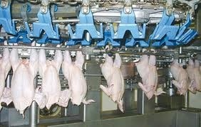
CCP
Example: slaughtering stage
Could this Hazard be controlled by PRPs? NO
Is there a control procedure in any processing step? Yes (Hand Slaughter)
Is the exposure to this Hazard may exceed the limits and beyond? Yes
Is the controlled procedure designed to remove or minimize the Hazard to an acceptable limit? Yes
Can another procedure on the processing line remove or minimize the Hazard to an acceptable limit? NO
CCP-H1
H: Halal

Slide 53
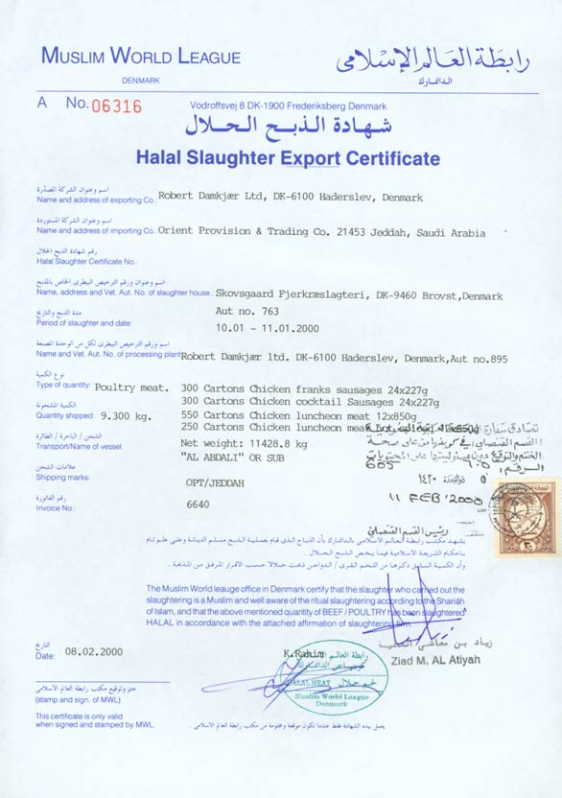

Critical Control Point #7:
The actual value of Halal certificates lies in knowing who issued them. Why? Because knowledge of Halal is a religious issue in which Halal and Haram will be based on and such knowledge is not accepted by non-Muslims or unidentified person.

Slide 54
-Halal
We can apply HACCP-Halal in manufactured Halal processed poultry meat where the monitoring of CCP will be more complicated.

Slide 55
Conclusions
Halal certification based on identifying potential Hazards of religious nature within the Halal chain will maximize the efficiency of Halal control.

Slide 56
Recommendations
Halal researches should be encouraged to identify Halal critical points in the main food and non-food products.

Slide 57
References
Official Documents on Food and Slaughter According to Islamic Rites, Dr. Hani Masnsour Al-Mazeedi, 1979-2016
Introduction to The Global Halal Industry and its Services, Darhim Dali Hashim, Halal Industry and its Services Conference, 24-26 January 2011, State of Kuwait, Salmiyah, Holiday Inn Hotel al-Salmiyah
Islamic supervision methodology of Halal Products: Halal Foods and Islamic Slaughtering, Dr. Hani Masnsour Al-Mazeedi and Dr. Zuhair Bin Shrooz Al-Mulla, 1st. Int. Conference on Halal Food Control, 12-15 February, 2012, InterContinental Hotel, Riyadh, Kingdom of Saudi Arabia
Traceability in Halal Products: A New Challenge and a Necessity in Halal Model Mohamed M. Mohamdi, Halal Feed and Food Inspection Authority (HFFIA), Netherlands. Extracted from the second Gulf conference on Halal industry and its services, Kuwait, 2013.
Mohammed Ayub Khan (McMaster University, Canada)
Council Directive 93/43/EEC

Slide 58
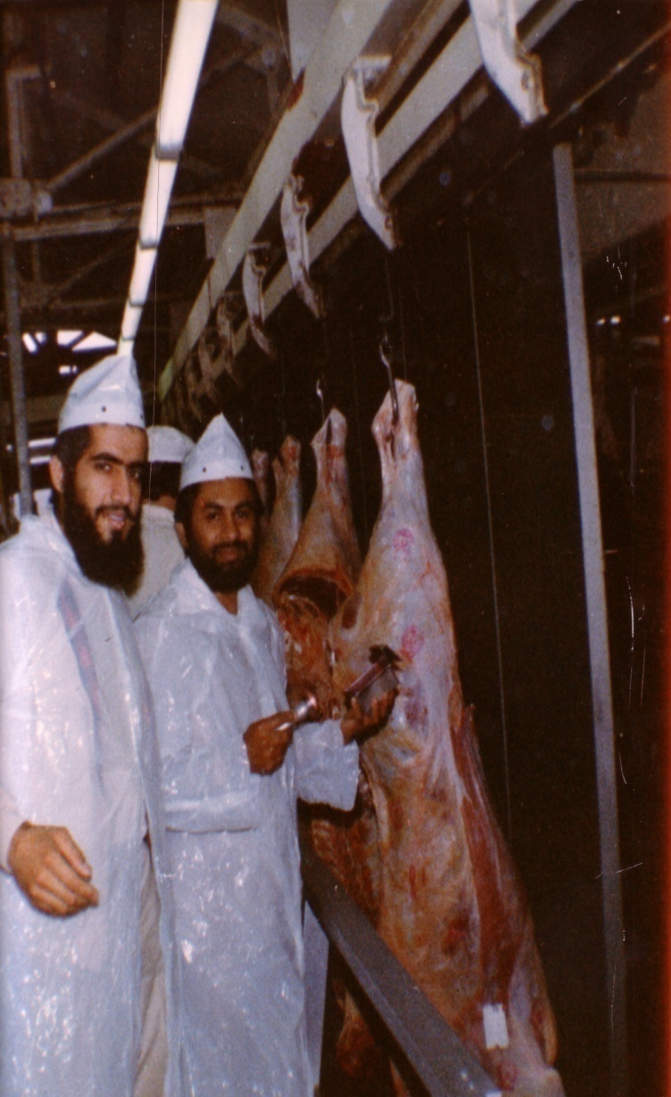
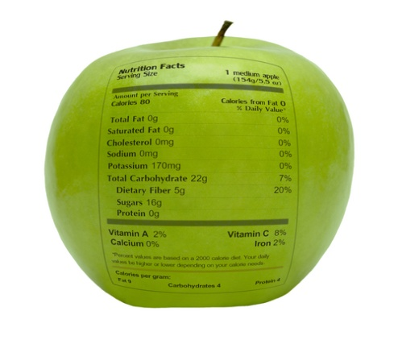
شكراً لاستماعكم
سبحنك اللهم وبحمدك أشهد أن لا إله إلا أنت، أستغفرك وأتوب إليك
د. هاني منصور المزيدي
مع الأخ أمجد محبوب في أستراليا سنة 1981
Dr. Hani Mansour Al-Mazeedi
With brother Amjad Mahboob in Australia in 1981

Slide 59

www.HalalEA.com
Trademarks, icons, images belong to their respective owners.
© Halal Sciences Academy Limited

